Slide 1
Foundations of Language
Chapter 3

Slide 2
Origins?
Theories:
Sound – language started as sound based (onomatopoeia)
However, this doesn’t really explain the words that we use that aren’t sound based.

Slide 3
Origins?
Theories:
Evolution –brain size increased, vocal chords development
However:
Has there been enough time for language to actually evolve?
Grammar doesn’t evolve (it is or is not – Chomsky)
Grammar isn’t something that saves your life (natural selection).

Slide 4
Origins?
Theories
Evolution reevaluated…
Now many of the original arguments have been resupported.
Natural advantage for communication
Helps you avoid predators, find food, etc.

Slide 5
Origins?
Theories
Evolution – protolanguage
The language between sounds and hand pointing and our current language
1.6 million years ago with Homo Erectus
So Chomsky’s all or nothing idea is not supported (even today)
Pidgins, young children, primates and sign language, critical periods

Slide 6
Origins?
Theories
Evolution – archeology
Changes in Broca’s area
Changes in tongue and larynx – fine motor control
Changes in brain size
Changes in intelligence

Slide 7
Origins?
Theories
Biology Development
Some recent evidence suggests the FOXP2 gene controls grammar – damage to that gene leads to language acquisition problems.
The mutation in this area was about 100k years ago, which developed Broca’s area

Slide 8
Origins?
Theories
Hands!
We ran out of hand gestures – so we needed to develop language to add to our communication abilities (survival)

Slide 9
Origins?
Theories
Hands Support
Our brains and great apes both have hemispheric specialization, Brodmann’s 44
Left = language
Brodmann’s 44 = Broca’s; activates using gestures

Slide 10
Origins?
Theories
Hands Support
Some species have left hemisphere dominance for sound production – but do not show a preference for gesture production.
We gave up left handedness equality by being able to speak and gesture
Therefore, we have a strong right handed dominance

Slide 11
Origins?
Theories
Interaction Theories
Language and evolution interacted with environment to solve goals of the time
Linguistic skills are necessary for complex symbol processing
Language is a reconfiguration of other cognitive systems to solve a goal

Slide 12
Animal Language
Do you think animals have language?

Slide 13
Animal Language
Communication systems
Communication – transmission of a signal that conveys information
Sender benefits from the recipient’s response
Signal – means that conveys the information (sound)

Slide 14
Animal Language
Communication system examples
Ants have smell signals (pheromones)
Honey bees wiggle dance
Primates use visual auditory tactile and olfactory signals
Dolphins and whales

Slide 15
Animal Language
First, we have to start by defining language and seeing if animals fit.
How would you define language?

Slide 16
Animal Language
Defining Language
Hockett’s Feature List (page 56 picture)

Slide 17
Animal Language
Defining Language
Animal language meets a lot of these…
Arbitrariness, Semanticity, openness…
So why do most people say NO to animal language?

Slide 18
Animal Language
Our language:
Voluntary control
Creative
Animal language seems to lack the richness of our language system

Slide 19
Animal Language
Our Language:
Syntax – five properties
Language is a discrete combination system - Meanings are retained when information is combined
Combinations are ordered for meaning
Sentences are built around verbs
There’s a distinction between content and function words
Recursion

Slide 20
Animal Language
Can we teach animals language?
Rico – learned over 200 object names
When you said something he didn’t know, he’d bring you something new in the room.
Lacked categorization skills (doll and ball are both toys)
What Chaser, another dog here: https://www.youtube.com/watch?v=_6479QAJuz8
Bonus! Neil Degrasse Tyson!

Slide 21
Animal Language
Alex
African Gray famous for learning simple language.
Watch an example of the same research: https://www.youtube.com/watch?v=4yd9g1fXtyI

Slide 22
Animal Language
Ape research
Apes are used primarily because cognitively they are not that different from us.

Slide 23
Animal Language
Research with Apes…Cognitive Implications
Language is not essential for many basic cognitive tasks
Some non-cognitive processes for linguistic development
Cognitive limitations are not the only reason apes do not have language

Slide 24
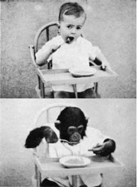
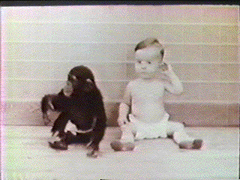
Animal Language
Gua and Viki

Slide 25
Animal Language
Gua and Viki
Kellogg and Kellogg research
Both chimps were raised with children in an attempt to see if they would pick up language
They were both unable to learn to speak

Slide 26
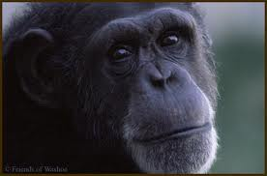
Animal Language
Washoe
https://youtu.be/3V_rAY0g9DM
Most research has focused on sign language or lexigram boards

Slide 27
Animal Language
Washoe
She was taught ASL and raised as a child (toilet training and everything!)
Was able to learn over 200 signs, made overgeneralization errors like children (flower = flower smells), create new signs for things she did not know (duck = waterbird)
Created basic syntactic sentences like kids (washoe sorry)
Some sensitivity to word order
Actually did teach some to offspring

Slide 28
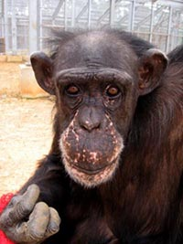
Animal Language
Sarah – Premack
Premackese – symbols and shapes that could be manipulated for language
She was able to create complex sentences and novel sentences with substitutions

Slide 29
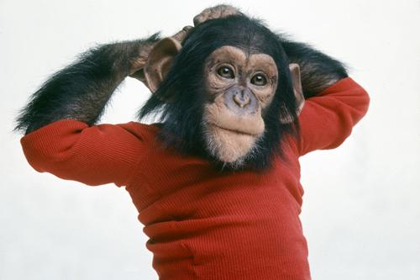
Animal Language
Nim Chimpsky!
Taught basically ASL
Short sentences showed word order, longer sentences showed repetition (go place, me eat banana banana eat)
https://youtu.be/u4T8ZeZy22M

Slide 30
Animal Language
Kanzi
Bonobo who has learned on the lexigram board
Shows spontaneous use of symbols
Sensitive to word order (syntax?)
Around the language of a 2-3 year old
Exposed early to language and always around people (may be the trick).

Slide 31
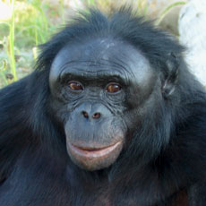
Animal Language
Watch Kanzi in action:
http://www.youtube.com/watch?v=wRM7vTrIIis

Slide 32
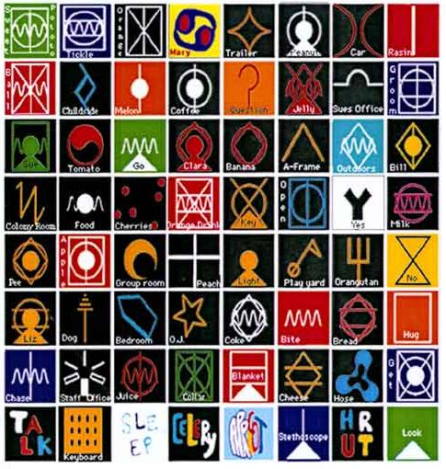
Animal Language

Slide 33
Animal Language
Methodological criticisms
ASL is very symbolic and differs from these boards (give, hungry) so it may match natural gestures apes use.
Many of the examples are anecdotal and do not present the events around the time
The data is reduced and doesn’t show all the repetitions
Many events are just learning situational cues (behaviorism!)

Slide 34
Animal Language
Overall
Lack a syntactic structure
Do not ask questions about language – which children do
Tend to sign about verbs and nouns
Lots of repetition

Slide 35
Animal Language
Overall
Usually to get food or another object
The main issue with ape language is if they understand the meaning of the symbols/signs the same way we do
We also cannot be sure of their ability to learn grammar – they can learn simple frames (complex conditioning) but not the hierarchical complicated grammar we use.

Slide 36
Biological Bases
Localization – we use lesion studies, fMRI, etc to study where exactly language occurs in the brain.

Slide 37
Biological Bases
Hemispheres
Right handed people = left hemisphere
Left handed people = half and half
Aphasia - disorder of language including a deficit or loss of expressive or receptive aspects of language
Syndrome - medical term for a cluster of symptoms that cohere as result of a single underlying cause

Slide 38
Biological Bases
Broca’s aphasia – slow laborious speech, difficulties in articulation
http://www.youtube.com/watch?v=f2IiMEbMnPM
Wernicke’s aphasia – poor comprehension and fluent often meaningless speech with clear word finding difficulties
http://www.youtube.com/watch?v=aVhYN7NTIKU

Slide 39
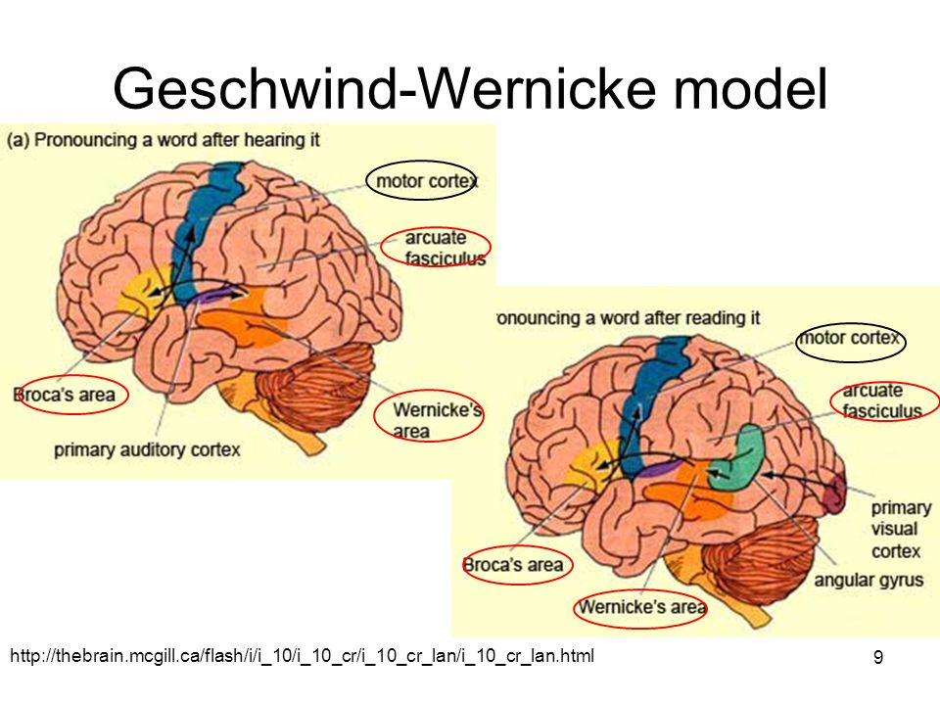
Biological Bases
Wernicke-Geschwind model

Slide 40
Biological Bases
Wernicke-Geschwind model
Hearing = auditory cortex -> Wernicke’s
Sound images of objects in Wernicke’s
Then arcuate fasciculus to Broca’s
Broca’s = articulation rules to make sounds
Sent to the motor cortex to actually speak

Slide 41
Biological Bases
Newer models
Include the right hemisphere dealing with prosody, visual word recognition
Ullman’s D/P model
Declarative system is the mental lexicon (fact knowledge), which is mainly in the temporal lobe
Procedural system is mental grammar based in the frontal lobes, cerebellum, and Broca’s
Big distinction is between rules and words

Slide 42
Biological Bases
Gender and language
What is the stereotype about language?

Slide 43
Biological Bases
Girls:
Talk before boys on average about 1 month
Better verbal and visual memories, better readers, and spellers
Use both cortexes for language processing – may explain differences
Boys
Better lateralization, right ear dominance

Slide 44
Biological Bases
Critical Periods
Certain biological events can only happen in an early critical period
Hemispheric specialization occurs and there’s lots of plasticity during that time.
Certain linguistic events must happen to the child during that period for development to be normal

Slide 45
Biological Bases
Critical Periods – Evidence
Maturation of the brain from birth – it’s not set when you are born, lateralization occurs with age
Plasticity after damage

Slide 46
Biological Bases
Critical Periods – Evidence
Lateralization hypotheses
Equipotentiality hypothesis – two hemispheres are similar at birth with language, so they can both get language
Irreversible determinism (invariance hypothesis) – left is set aside at birth, but the right will take over if there is damage
Emergentist account – is a combination of the two, the brain prefers the left hemisphere, but can be plastic if necessary

Slide 47
Biological Bases
Critical Periods – 2nd Languages
Maturational state hypothesis – our ability to learn languages declines with age, which makes it hard to learn the second language.
Exercise hypothesis – unless our capacity to learn languages is exercised then it is lost, which explains why people who know 3 languages find learning the next language even easier.

Slide 48
Biological Bases
Critical Periods – 2nd Languages
Adults actually do better learning a 2nd language (memory issues?)
However, children are better at sounding native because of phonological sound development
The decline in ability is gradual and continuous, not a cutoff point

Slide 49
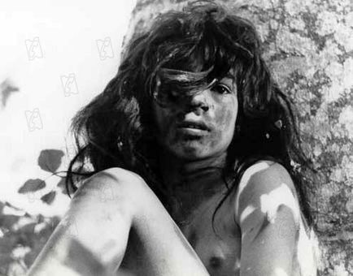
Biological Bases
Critical Periods – No Input?
Feral children have no language at all, and find it difficult to learn even with intense training.
Wild boy of Aveyron – found in the woods in the 1800s, never learned language, as well as other wolf and monkey children found in India and Burundi

Slide 50
Biological Bases
Critical Periods – No Input?
Genie – she was put in a closet from about 2 years old until about 14 years old, strapped to a potty chair.
She had contact with humans, but only when fed and other family barked at her.
No noise in the house, no tv.
She was able to learn some language, but never morphology, and many parts of grammar. (2-3 year only language).

Slide 51
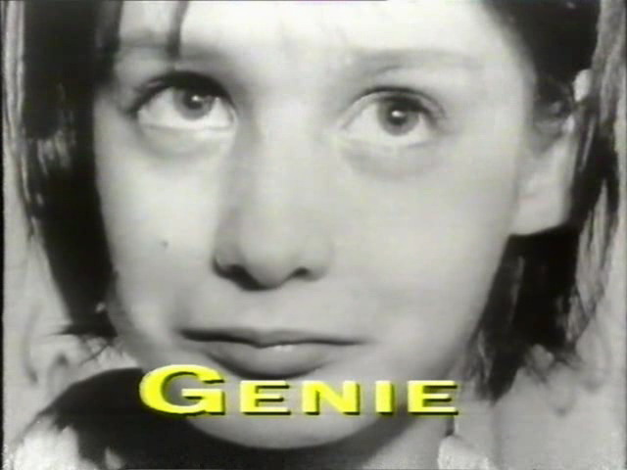
Biological Bases
Genie
https://youtu.be/VjZolHCrC8E

Slide 52
Biological Bases
Instead of Critical Periods
Sensitive period hypothesis – we cannot accept the full version of critical periods because language can be learned, and lateralization may be present at birth.

Slide 53
Biological Bases
Why sensitive periods?
Nativist explanation – brain is preprogrammed to acquire language early in development
Maturational explanation – advantages are lost as cognitive and neurological systems mature
Actually an advantage that kids are “slow” because it allows them to take in smaller chunks (less is more)
Critical/Sensitive Periods are half nature/half nurture

Slide 54
Cognitive Bases
Piaget’s Stages of Development
Sensorimotor period – behavior is organized around senses and motor systems, must learn object permanence (things are there even when you can’t see them)
Pre-operational stage – egocentric though, which means that you can’t take another person’s point of view

Slide 55
Cognitive Bases
Piaget’s Stages of Development
Concrete operational stage – can do the conservation task, can take other’s point of view.
Formal operations stage – when you are able to reason abstractly
http://www.youtube.com/watch?v=YtLEWVu815o

Slide 56
Cognitive Bases
Piaget’s Developmental Mechanisms
Assimilation – information is fit into existing cognitive structures
Accommodation - cognitive structures are changed to allow for new information

Slide 57
Cognitive Bases
Cognitive hypothesis – language needs certain cognitive precursors to develop
You have to get object permanence to be able to gain the vocabulary/dictionary
Working memory and memory must develop
Hard to test this theory…

Slide 58
Social Bases
For language to develop naturally, a social interaction is necessary (i.e. you can’t just leave kids in front of the tv)
Many believe grammar is implicitly reinforced by social interactions

Slide 59
Social Bases
Turn taking
We learn how to use the language in a social interaction
Turn taking begins at early age – mothers and children do not tend to talk at the same time
Attentional Frame Theory - Tomasello

Slide 60
Blind and Deaf Language
Visually Impaired Children
Slower cognitive development = slower vocabulary development
More action words and less nouns, function words
Phonological development is slower because we use mouth movements to help use distinguish different phonemes
Syntactic development has more repetition than normal

Slide 61
Blind and Deaf Language
Hearing impaired children
Gain language at the same rate and tend to have similar cognitive developments
Overall
These studies show that cognitive development may not be an influencing factor, but that social interaction is an important factor

Slide 62
Language and Thought
What exactly the relationship between language and thought? You can speak without thinking (yipes!) and think without speaking. People without speech can still think (even use language and write).

Slide 63
Language and Thought
Theories
Piaget – cognitive development determines the course of language development
Chomsky – language and cognition are completely separate entities
Vygotsky – language and cognition originate independently but become interdependent
Sapir-Whorf – language determines thought

Slide 64
Language and Thought
Vygotsky
Speech and thought have different origins
Pre-intellectual stage – words are not symbols for objects, they are sounds without thought (Grayson uh oh)
Early speech is egocentric to help interactions – these are thoughts and language merged

Slide 65
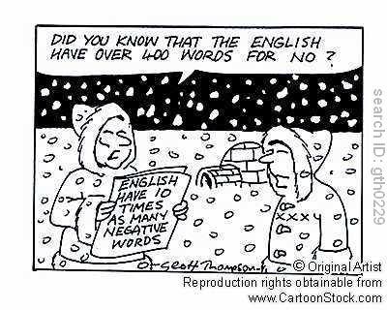
Language and Thought
Sapir-Whorf Hypothesis
The form of our language determines the structure of our thought process

Slide 66
Language and Thought
Sapir-Whorf Hypothesis
Linguistic determinism – the form and characteristics of our language determine the way in which we think, remember and perceive
Linguistic relativism – as many different languages will generate different cognitive structures

Slide 67
Language and Thought
Sapir-Whorf Hypothesis
Most people accept the weak version – language differences affect processing on certain tasks where linguistic coding is important

Slide 68
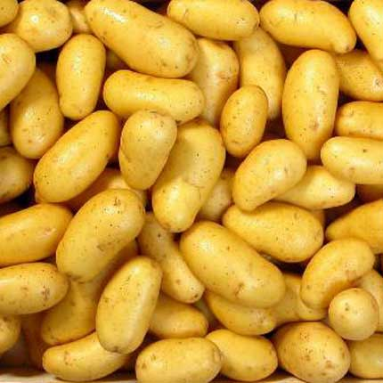
Language and Thought
Sapir-Whorf Evidence
Translations of languages “sound funny” – pomme de terre (apple of the earth – so do French people think about potatoes differently than us?)

Slide 69
Language and Thought
Sapir-Whorf Evidence
Whorfian hypothesis – some languages have more words for things than others (more words for snow in Inuit) so they must think differently about them than other languages
However, vocabulary differences tend to reflect different experiences (think about a job where you would have to “learn the lingo”)

Slide 70
Language and Thought
Sapir-Whorf Evidence
Grammar differences – gender markings in different languages, those markers are useful when determining sex but not things like pencil

Slide 71
Language and Thought
Interaction Theory
There is an interaction between language and thought.
Evidence
Candle box problem – functional fixedness – our thoughts of something for what it’s meant to be used for can limit us
The language we use influences the stereotypes we assume (English speakers assume English stereotypes)

Slide 72
Language and Thought
Interaction Evidence
Number learning is much harder in English because of all the special terms we have for learning numbers
Overall
There appears to be a complex interaction between language and thought.

